Slide 1
COMPUTING DERIVATIVES
During the last lecture we built some “bricks” (derivatives of four actual functions) and some “mortar” (commonly known as “rules of differentiation.”)
We can now apply the mortar to the bricks and start building a collection of known derivatives.
Before we start, let me review a method of proof that is a little subtle and apparently tautological, called the method of induction, better illustrated
Notes:
W for whatever, …

Slide 2

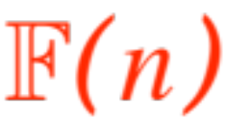
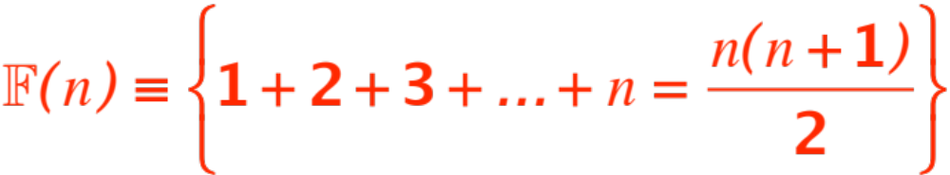
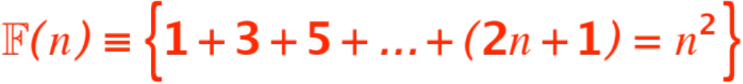
as the Domino Theory.
Suppose you have a formula that depends on an integer and may or may not be true (in computer terminology we say the formula has a boolean value, (from George Boole, look him up on wikipedia!), let’s denote the formula by
Here is an example:
(true)
(false)

Slide 3

Suppose you would like to prove that a certain formula
Is true for all values of . You can try a …
proof by induction (computer people call this
recursion,
your textbook discusses it on p. 97 )
Here is how it works:

Slide 4


Verify that is true (this is called
the base case
Prove that if is true (the induction
assumption) then is true.
If you can do this, then you have proved that
is true for all integers .
We can use this method (as well as sometimes a direct proof) to build a few more bricks in the differentiation building.

Slide 5
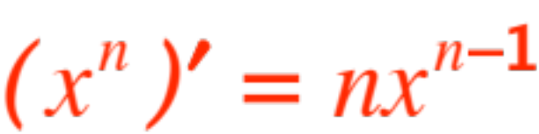
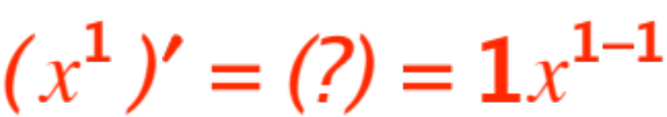

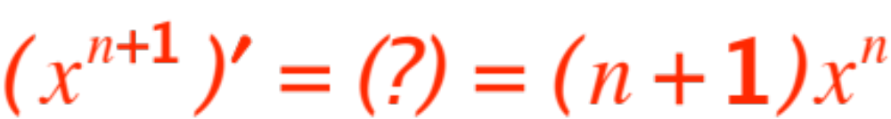
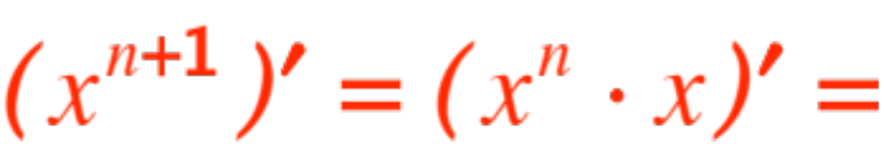
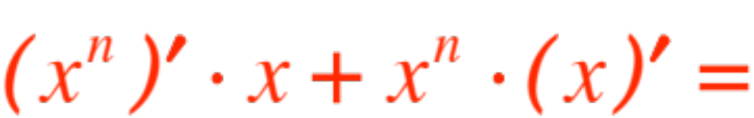
(the power rule for positive exponents)
(in words, decrease the exponent by 1, move the old exponent down as a multiplier.)
Base case:
Induction assumption:
To prove:
Here we go:
(product rule)
(by ind. assmpt)

Slide 6
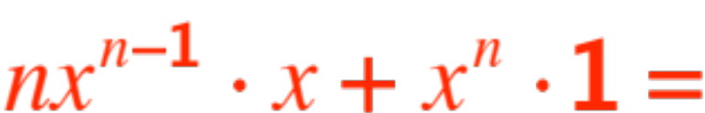
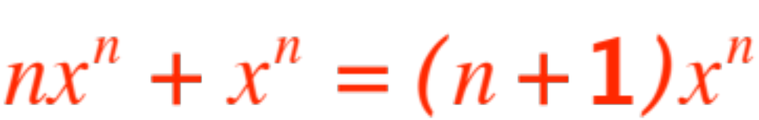
(we repeat for ease of reading)
VOILÁ, another brick!
This particular statement is amenable to a direct proof, using a difference quotient, but one needs to know
Newton’s binomial formula, that probably some of you do not know.

Slide 7
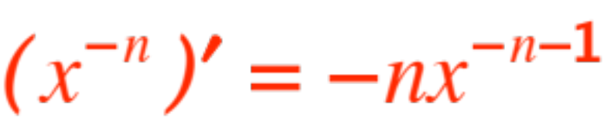
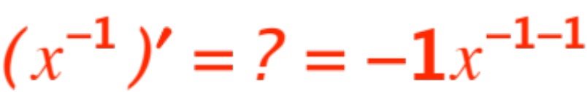
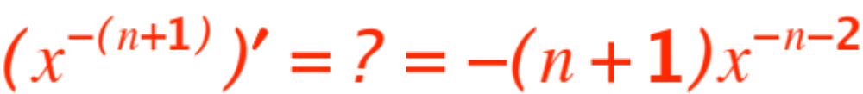
(one more brick)
In words this is the same as before, decrease the exponent by 1, move the old exponent down as a multiplier.
Once more we use induction:
Base case
(that’s our third elementary brick )
Induction hypothesis
Must prove

Slide 8
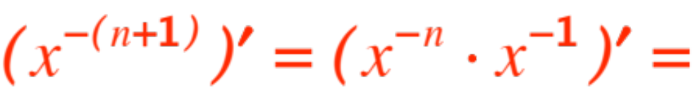
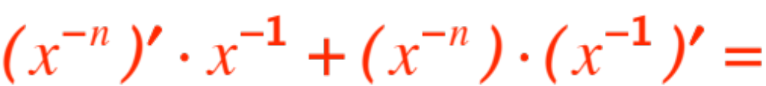
We start from the left and hope to get to the right.
(Product rule)
(ind. assumption and known brick)
(8th grade algebra)
Remark. I stress again that in words the rule stays the same, move the exponent down as a multiplier, decrease the exponent by 1.

Slide 9
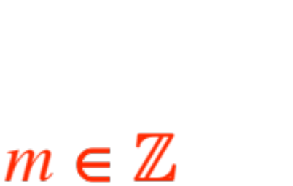
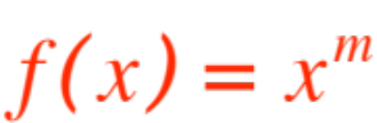
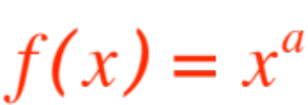

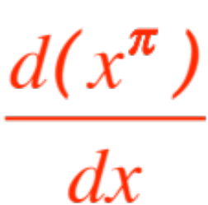

This is a neat (cool, nice, bad, what’s the jargon nowadays?) rule for the derivative of a power function ,
But you know more general power functions, namely ,
Will the same rule (known as the power rule) still hold?
The answer is YES, but we will only prove it for
, you will compute next sem.

Slide 10
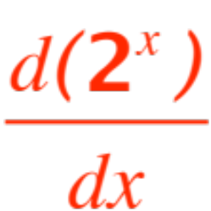
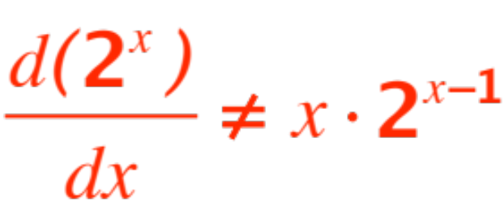
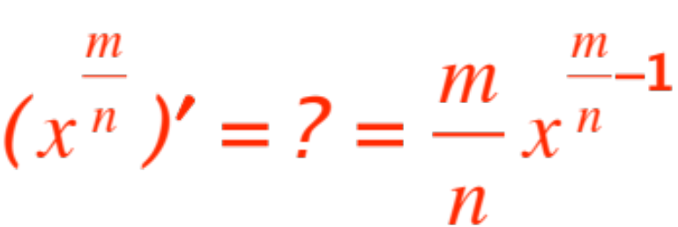
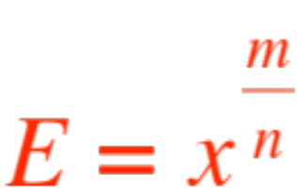

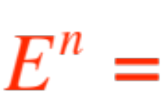
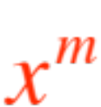
I think next semester you will also compute
, but unfortunately the rule breaks down,
Let’s get back to our work, I’d like to show that
Let
(E for easier.) We need to compute . We know that

Slide 11
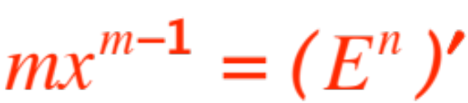
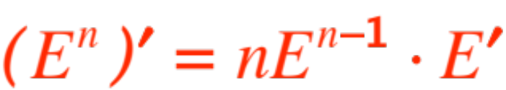

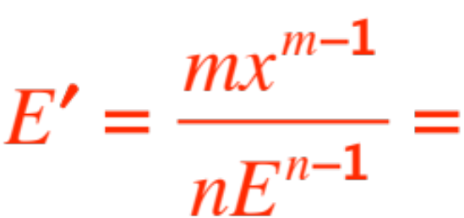
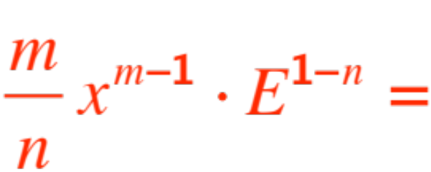
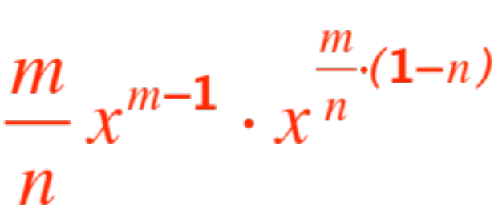
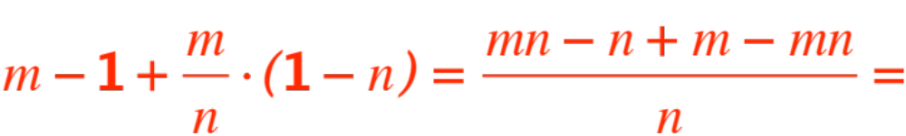
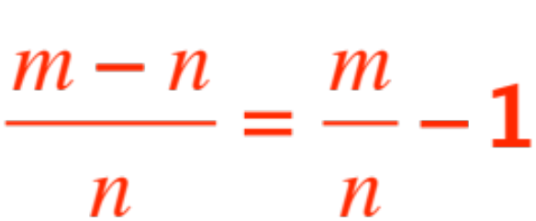

Therefore . By the chain rule
, so we get
and therefore
Now 7th grade algebra shows that

Slide 12
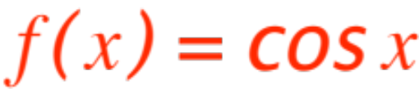
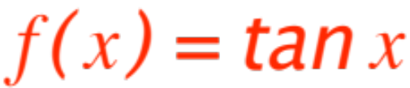
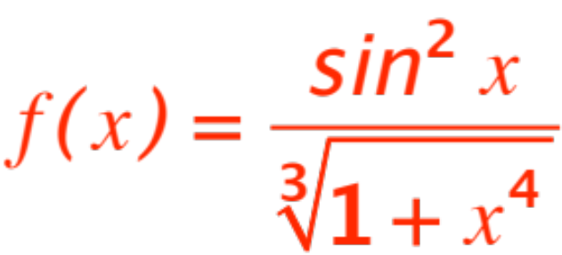
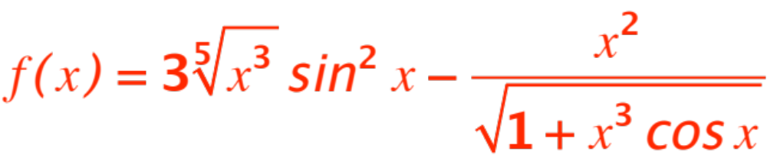
The (extended) power rule, the five rules of differentiation (sum, scalar product, product, inverse, chain rule) and our few simple bricks allow us enormous power to compute derivatives! I will make a list of a few funtions and compute their derivatives at the board.

Slide 13
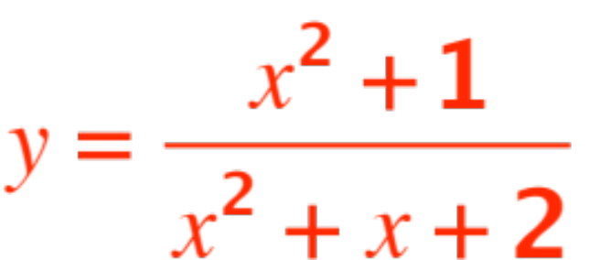

Tangents and Velocities
Find the equation of the straight line tangent to the graph of
at
The distance from earth of a falling meteor (in m) is given by
1. How far from the earth is it at time t = 0?
2.How fast is it traveling at time t = 0?
3. How fast is it going when it hits the earth?

